Slide 1
Can you remember from your school days?
How you would answer these?
345 + 673 =
455 - 274 =
23 x 15 =
63 ÷ 3 =
Notes:
jf

Slide 2
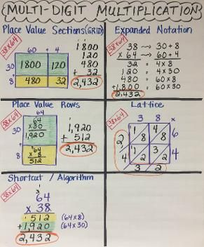
One calculation - many methods!!!
38 x 64 = 2432
Notes:
jf

Slide 3
Aims of the session
Share the main methods for the 4 operations in maths
Show you how to do the methods we use
Provide support for you as parents to aid your children with their learning
Share resources for you to use to help your child
Notes:
KB

Slide 4
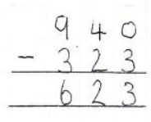
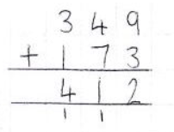
Errors in Year 6 SATS
Notes:
KB

Slide 5
Fluency help
Number bonds
Times tables
Doubling and halving
Partitioning
Notes:
KB
Compliments race, show me
Counting times tables - quick recall, chanting in order and out of order
Doubling - keep doubling
Street numbers - around us
Partitioning in many ways - whiteboards and link to money

Slide 6
ADDITION
351 + 213 =

Slide 7

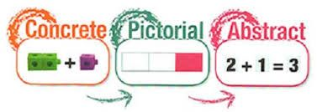
Notes:
KB Conceptual not just procedural - vital
Key way to achieve this is by showing them what the method means and help them to understand this.
Way to help this is CPA

Slide 8





Have a think
564
Hundreds | Tens | Ones
 | H | T | O
 | 3 | 5 | 1
 | 2 | 1 | 3
+
+
5
6
4
5
6
4
ones
tens
hundreds
Do we have enough _______ to make an exchange?

Slide 9
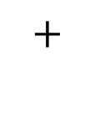
Dexter scores 371 points in a game.
Rosie scores 263 points.
How much do they score altogether?
634
Hundreds | Tens | Ones
 | H | T | O
 | 3 | 7 | 1
 | 2 | 6 | 3
6
3
4
1
6
3
4

Slide 10
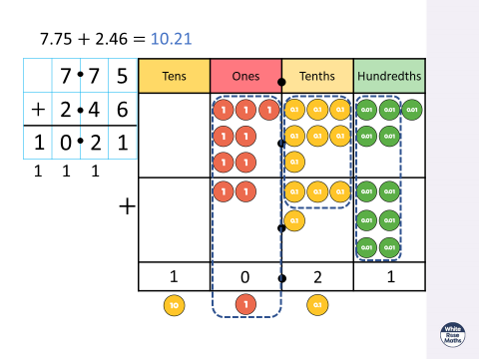

Slide 11
SUBTRACTION
438 - 325 =
Notes:
JF

Slide 12


113
Hundreds | Tens | Ones
 | H | T | O
 | 4 | 3 | 8
 | 3 | 2 | 5
1
1
3
1
1
3
Do we need to make an exchange?

Slide 13


325
Hundreds | Tens | Ones
 | H | T | O
 | 3 | 5 | 1
4
1
2
6
3
2
5
3
2
5

Slide 14
MULTIPLICATION
Notes:
JF

Slide 15
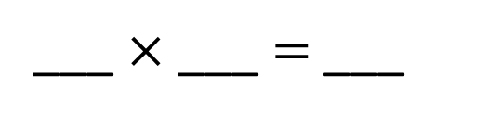
Have a think
T | O
22
4
88
What calculation is shown?

Slide 16
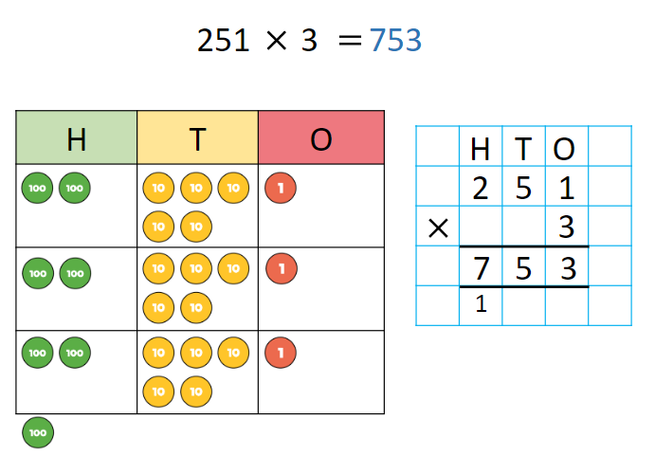

Slide 17
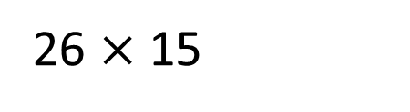




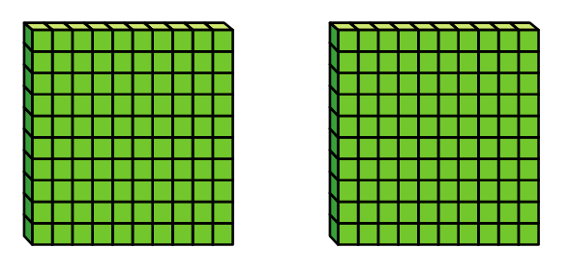
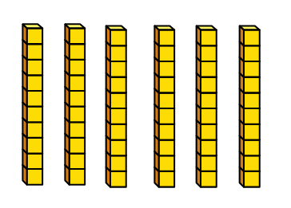

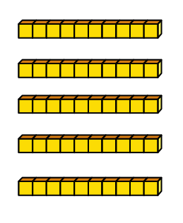
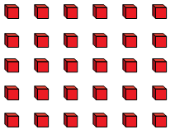

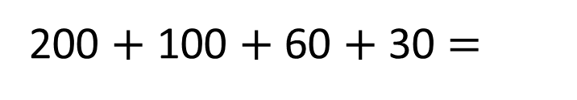
20
6
200
10
60
100
5
30
390
What do you notice?

Slide 18
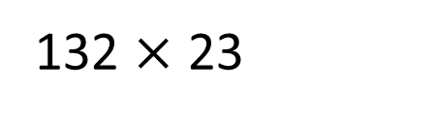
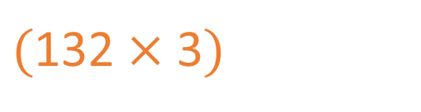
 | Th | H | T | O
 |  | 1 | 3 | 2
 |  |  | 2 | 3
X
3
3
9
6
+

Slide 19
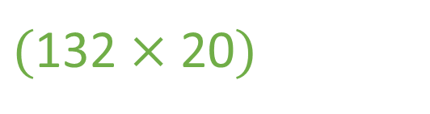
 | Th | H | T | O
 |  | 1 | 3 | 2
 |  |  | 2 | 3
X
2
3
9
6
+
2
6
4
0
3
0
3
6
1
1

Slide 20
DIVISION
Notes:
KB

Slide 21
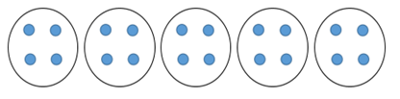
Division - Y1 and Y2
20 ÷ 5 = 4
Sharing and grouping
Notes:
KB

Slide 22
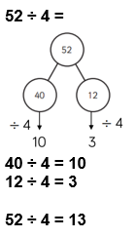
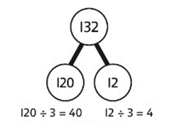
Division - Y3 and Y4
Notes:
KB
Part whole model

Slide 23

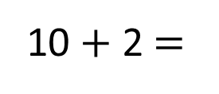
Year 3
48 ÷ 4 =
12
48
Tens | Ones
40
8
÷ 4
÷ 4
10
2
12

Slide 24
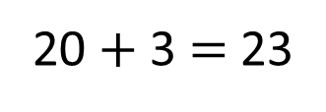
Year 4
115 ÷ 5 =
23
H | T | O
115
100
15
÷ 5
÷ 5
20
3

Slide 25
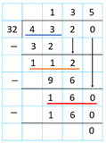
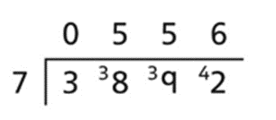
Division
Notes:
KB

Slide 26
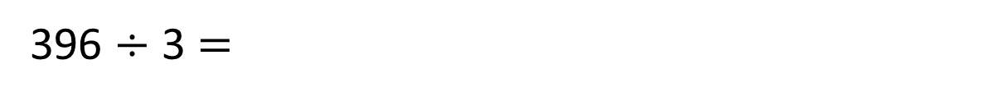
Year 5
H | T | O
 | 3 | 3 | 9 | 6
1
3
2
Have a think

Slide 27
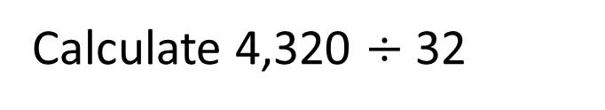
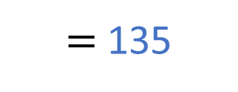



Year 6
32
64
96
128
160
192
32 | 4 | 3 | 2 | 0
1
3
5
3 2
1 1
2
9 6
1 6
0
1 6 0
0

Slide 28
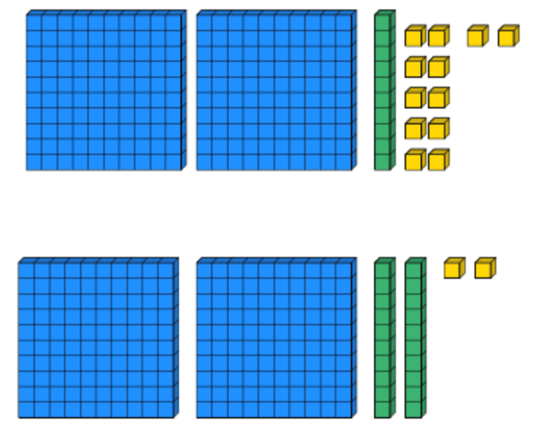

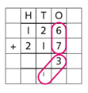
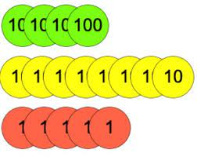
IMPORTANT LANGUAGE
Concrete materials
Dienes
Place value counters
Place value chart
Exchanging
Not carrying or borrowing
Regrouping and flexible partitioning
Notes:
JF

Slide 29
Where can you get help?
Sample textbooks and workbooks
Fluency links:
Multiplication tables check
Top marks
Defenders of Mathmatica
Hit the button
Daily Ten
Bug Club assigned games : ActiveLearn: Login (activelearnprimary.co.uk)
Notes:
KB

