Slide 1
SATS
PARENT SESSION
2025

Slide 2
Information Session
The Exams
The SATs week
How to best prepare
Materials
Q & A

Slide 3
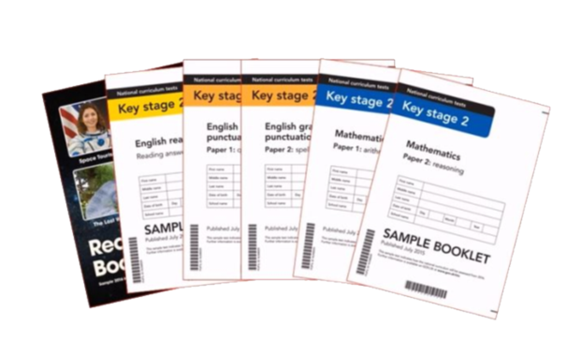

The Exams
Grammar & Punctuation Test (45 minutes)
Spelling Test (15 minutes)
Reading Test (1 hour)
Maths Arithmetic Test (30 minutes)
2x Maths Reasoning Test (40 minutes each)
Notes:
These are statutory assessments that every year 6 child who attends a mainstream school will be taking on the same day at the same time.
The tests will be on everything the children have learnt since year 3 (while they’ve been in KS2)
Test scores are used to assess the effectiveness of the teaching in the school and compare the school against others across the country
Secondary schools also use the data as a baseline

Slide 4
SATs Week
Monday 12th May - Thursday 15th May 2025
Monday 12th
Tuesday 13th
Wednesday 14th
Thursday 15th
Spelling, Punctuation & Grammar Tests
Reading
Test
Arithmetic Test
&
Maths
Reasoning
Test (1)
Maths Reasoning
Test (2)

Slide 5
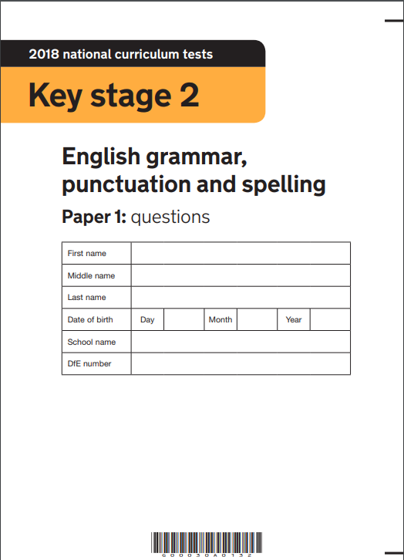
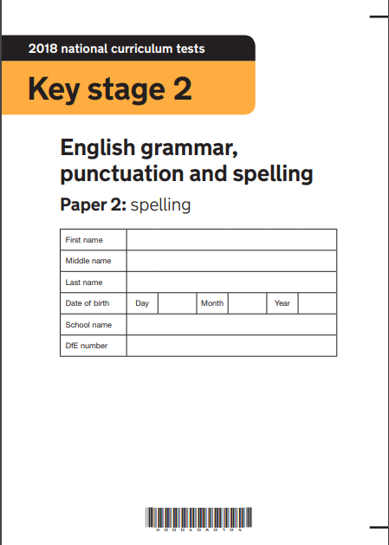
Spelling, Punctuation & Grammar SATS
Monday 12th May 2025
Grammar & Punctuation Test 45 minutes
(answer around 40 questions testing their use of punctuation and knowledge of grammatical terms)
Spelling Test 15 minutes

Slide 6
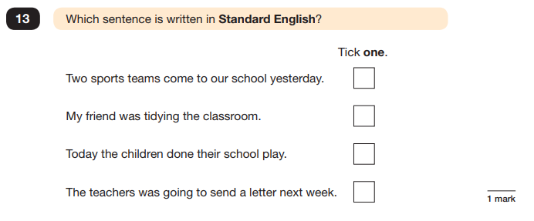
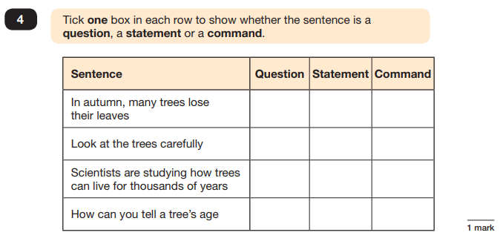
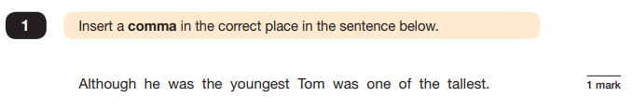
Spelling, Punctuation & Grammar SATS

Slide 7

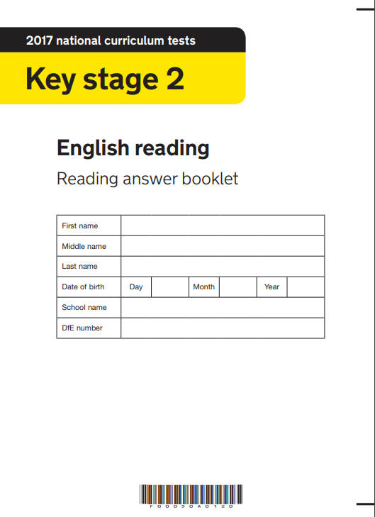
Reading SATS
Tuesday 13th May 2025
60 minutes test
(read and answer questions based on three different texts, both fiction and non-fiction)
Children will be asked questions on the following areas:
Make Comparisons
Identify author's intent
Explain vocabulary
QUICK TIP
Read with your child, even if they are a fluent reader, and ask them questions about the characters or plot.
Summarise
Make inferences
Identify & Retrieve information
Predict

Slide 8
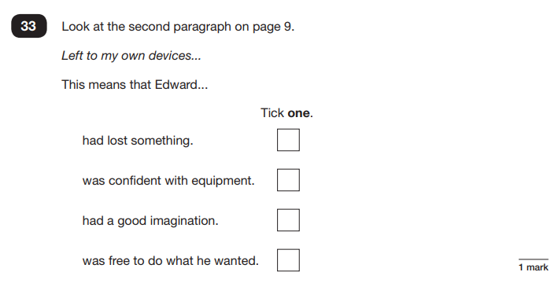
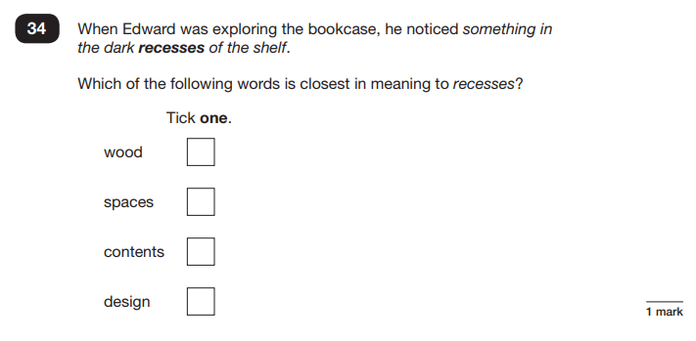
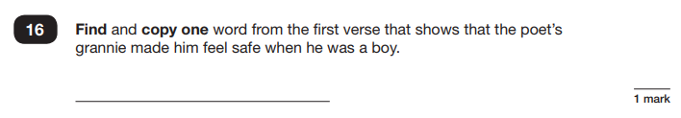
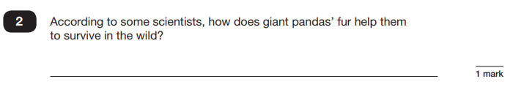
Reading SATS

Slide 9
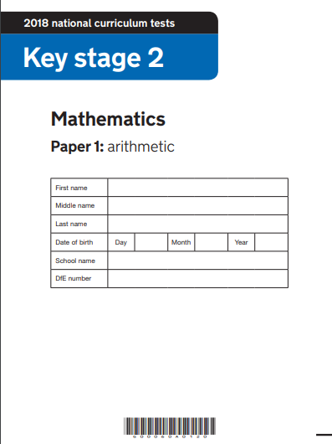
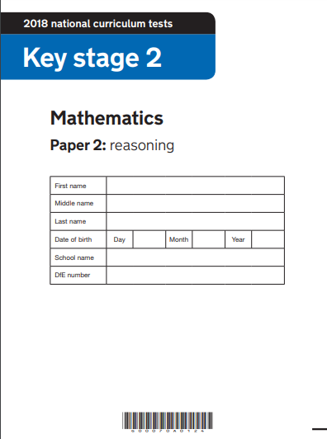
Maths SATS
Wednesday 14th & Thursday 15th May 2025
Arithmetic Test 30 minute test
Assesses children’s confidence using written calculation as well as fractions, percentages and decimals.
Reasoning Test 40 minute test x2
Focuses on problem solving and applying mathematical reasoning.

Slide 10
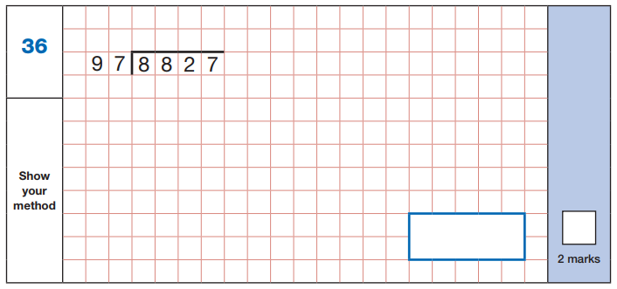
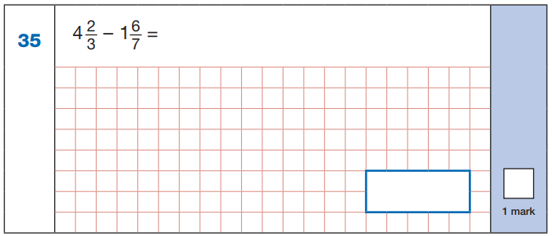
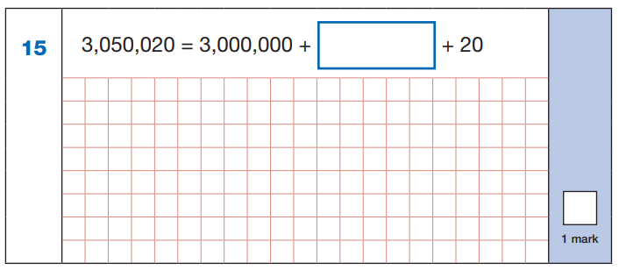
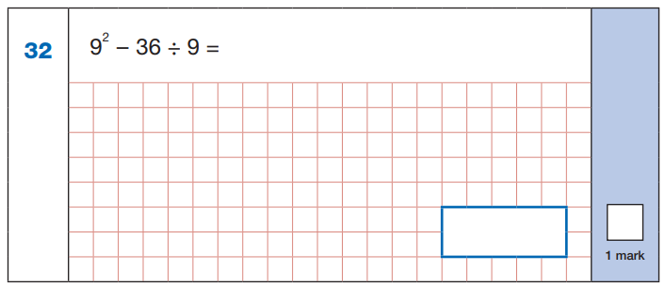
Maths Arithmetic SATS

Slide 11
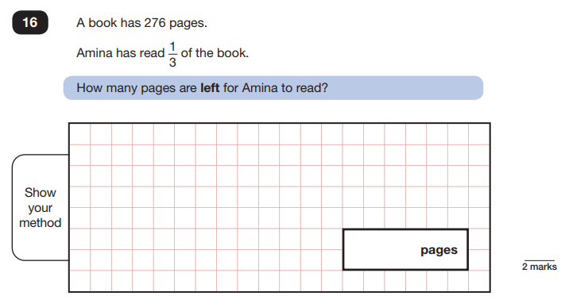
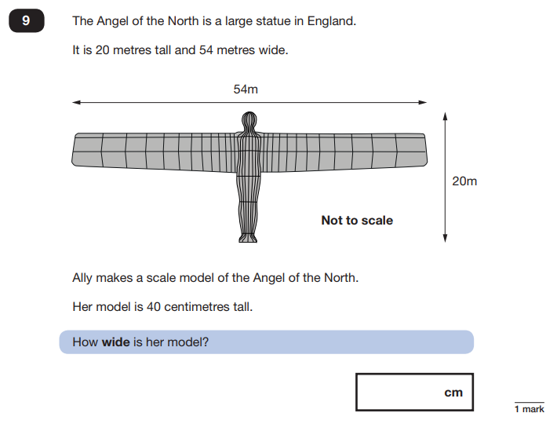
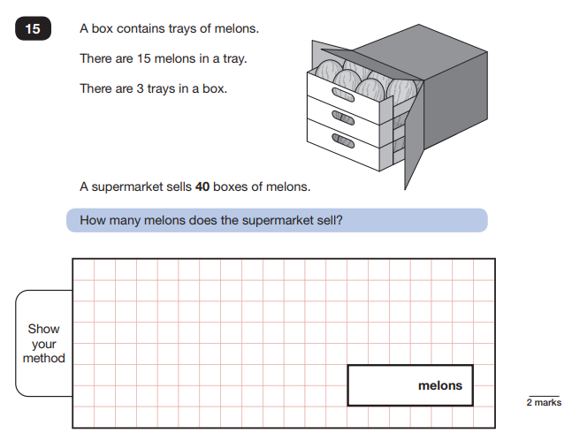
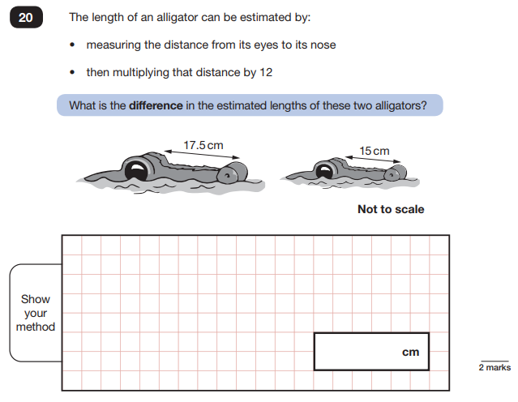
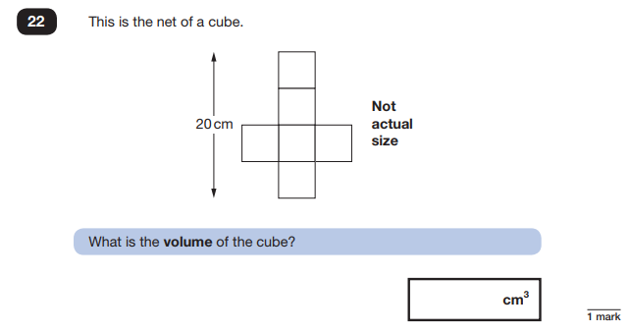
Maths Reasoning SATS

Slide 12
How to prepare for SATs
Help your child not to worry or feel pressured by the SATs through lots of praise and encouragement.
Support your children with any homework, including spellings, regular reading, Bug Club, Times Table Rockstars, maths work etc
Help them to have early nights and a healthy diet.
Help them to have the best possible attendance at school.
Speak to a member of staff if you have any questions or concerns.
Notes:
Could mention the revision guides at this point

Slide 13
SATs FAQ
When will the tests happen?
Where in the school will the children take the tests?
Who marks the SATs papers?
When will the children find out how well they did?

Slide 14
SATs FAQ
Can you fail the SATs?
What happens if my child is ill on SATs Week?
Are the children allowed help from a teacher in the SATs?

Slide 15
Q & A

