Slide 1
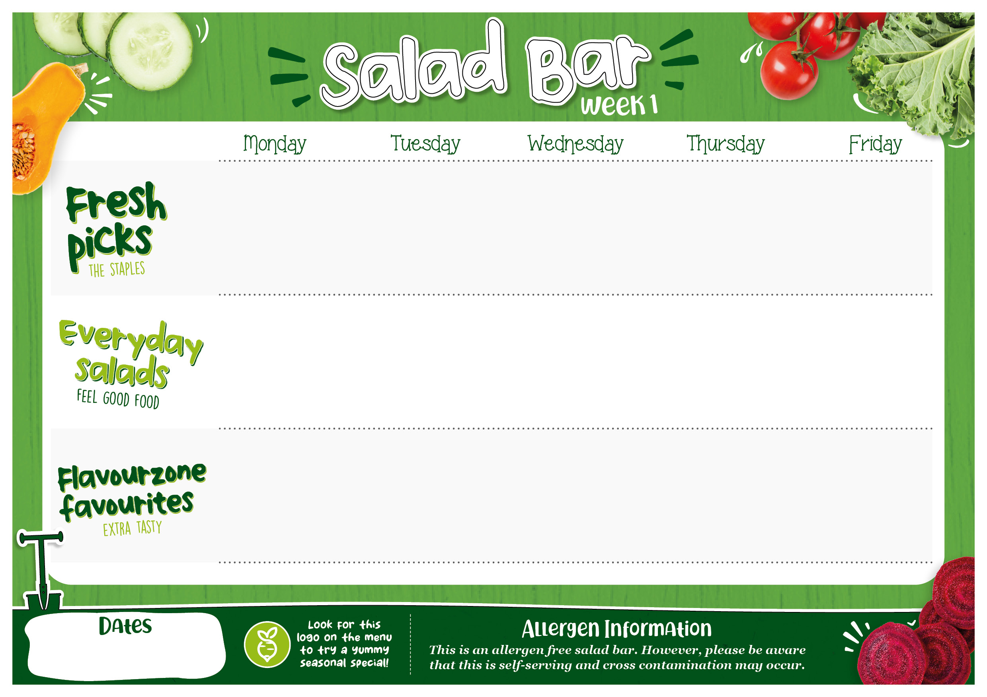

Iceberg Lettuce Sliced Cucumber Tomato Wedges Sliced Red Onion Diced Beetroot Grated Carrots | Iceberg Lettuce Sliced Cucumber Tomato Wedges Sliced Red Onion Diced Beetroot Grated Carrots | Rocket Salad Diced Cucumber Mixed Tomatoes Grated Carrot Sweetcorn Sliced Peppers | Rocket Salad Diced Cucumber Mixed Tomatoes Grated Carrot Sweetcorn Sliced Peppers | Iceberg Lettuce Cherry Tomatoes Cucumber Sweetcorn Shredded Carrots
Classic Potato Salad Tomato and Basil Salad | Classic Potato salad Tomato and Basil Salad | Beetroot and Chickpea Salad Persian Style Minted Salad | Beetroot and Chickpea Salad Persian Style Minted Salad | Chef’s Choice of Salads (must be allergen free)
Pumpkin Seeds Sunflower Seeds Crispy Onions Raisins Flavoured Oils | Pumpkin Seeds Sunflower Seeds Crispy Onions Lemon Wedges Flavoured Oils | Sunflower Seeds Sliced Black Olives Pickled Onion Raisins Flavoured Oils | Sunflower Seeds Sliced Black Olives Pickled Onion Raisins Flavoured Oils | Taco Crumbs Sunflower Seeds Rocket Pesto Raisins Flavoured Oils
13/4/26, 11/5/26, 8/6/26, 6/7/26

Slide 2

Iceberg Lettuce Cherry Tomatoes Cucumbers Sweetcorn Roasted Red Peppers Shredded Carrots | Iceberg Lettuce Cherry Tomatoes Cucumbers Sweetcorn Roasted Red Peppers Shredded Carrots | Mixed Leaves Salad Tomatoes Courgette Ribbons Sliced Red Onion Baby Spinach Cucumber | Mixed Leaves Salad Tomatoes Courgette Ribbons Sliced Red Onion Baby Spinach Cucumber | Lettuce Leaves Cherry Tomatoes Cucumber Sweetcorn Grated Carrots
Crunchy Mint and Basil Salad Cowboy’s Potato Salad | Crunchy Mint and Basil Salad Cowboy’s Potato Salad | Rocket, Beetroot and Quinoa Salad Cucumber and Mint Salad | Rocket, Beetroot and Quinoa Salad Cucumber and Mint Salad | Chef’s Choice of Salads (must be allergen free)
Taco Crumbs Pumpkin Seeds Raisins Rocket Pesto Flavoured Oils | Crispy Onions Pumpkin Seeds Raisins Rocket Pesto Flavoured Oils | Dill Pickled Vegetables Sultanas Sunflower Seeds Crispy Onions Flavoured Oils | Dill Pickled Vegetables Sultanas Sunflower Seeds Crispy Onions Flavoured Oils | Taco Crumbs Pumpkin Seeds Sunflower Seeds Raisins Flavoured Oils
20/4/26, 18/5/26, 15/6/26, 13/7/26

Slide 3

Sweetcorn Baby Gem Cucumber Grated Carrot Cherry Tomatoes Mixed Peppers | Sweetcorn Baby Gem Cucumber Grated Carrot Cherry Tomatoes Mixed Peppers | Tomato Baby Spinach Cucumber Sticks Mixed Peppers Diced Beetroot Grilled Courgette | Tomato Baby Spinach Cucumber Sticks Mixed Peppers Diced Beetroot Grilled Courgette | Shredded Iceberg Cucumber Tomato Sliced Peppers Sweetcorn
Big Green Salad Honey and Beetroot Salad | Big Green Salad Honey and Beetroot Salad | Italian Style Potato Salad Summer Salad with Basil | Italian Style Potato Salad Summer Salad with Basil | Chef’s Choice of Salads (must be allergen free)
Raisins Banana Chips Pumpkin Seeds Sunflower Seeds Flavoured Oils | Raisins Banana Chips Pumpkin Seeds Sunflower Seeds Flavoured Oils | Taco Crumbs Pickled Vegetables Sunflower Seeds Sliced Black Olives Flavoured oils | Crispy Onions Pickled Vegetables Sunflower Seeds Sliced Black Olives Flavoured oils | Crispy Onions Banana Chips Sunflower Seeds Raisins Flavoured oils
27/4/26, 22/6/26, 20/7/26

Slide 4

Carrot Batons Lettuce Cucumber Sticks Tomato Wedges Sliced Mixed Peppers Sweetcorn | Carrot Batons Baby Spinach Cucumber Sticks Tomato Wedges Sliced Mixed Peppers Sweetcorn | Shredded Red Cabbage Gem Lettuce Cucumber Red Radish Tomatoes Beetroot | Shredded Red Cabbage Gem Lettuce Cucumber Red Radish Tomatoes Beetroot | Baby Spinach Diced Cucumber Mixed Tomatoes Grated Carrot Beetroot
Basil, Butterbean and Tomato Salad Mint and Beetroot Salad | Basil, Butterbean and Tomato Salad Mint and Beetroot Salad | Mint, Tomato and Watermelon Salad Green Potato Salad | Mint, Tomato and Watermelon Salad Green Potato Salad | Chef’s Choice of Salads (must be allergen free)
Raisins Crispy Onions Taco Crumbs Pumpkin Seeds Flavoured Oils | Raisins Crispy Onions Sliced Black Olives Pumpkin Seeds Flavoured Oils | Spinach Pesto Raisins Pumpkin Seeds Sunflower Seeds Flavoured Oils | Spinach Pesto Raisins Pumpkin Seeds Sunflower Seeds Flavoured Oils | Lemon Wedges Pumpkin Seeds Sunflower Seeds Raisins Flavoured Oils
4/5/26, 1/6/26, 29/6/26

